Slide 1
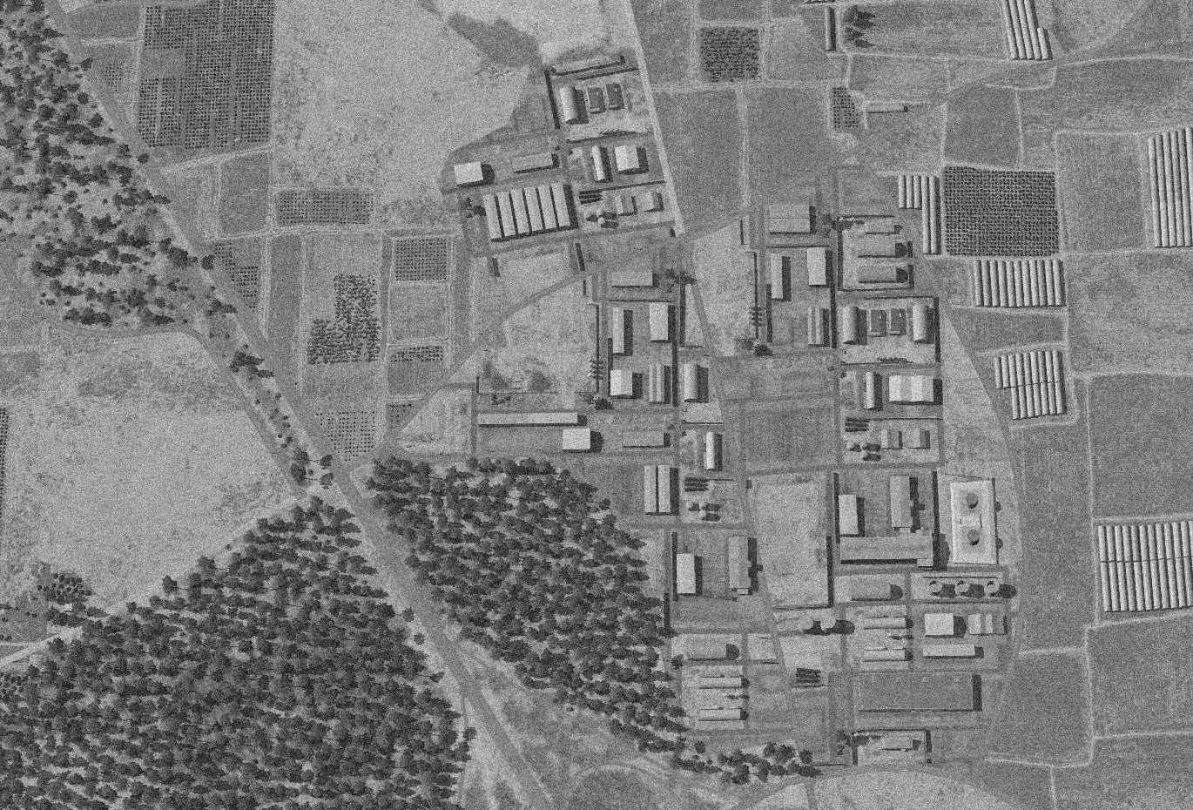
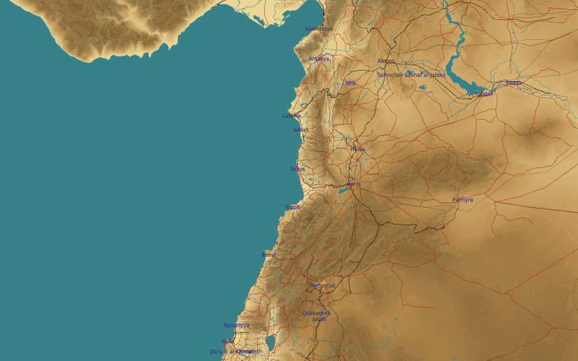
OPARTGT008 TARTUS AMMUNITION FACTORY
N
08
10
11
7
8
DESIRED POINT of IMPACT:
DPI 11 - N34 54.866 E 35 54.304 / 219ft / 1000lb bomb
DPI 10 - N34 54.868 E 35 54.254 / 219ft / 1000lb bomb
DPI 9 - N34 54.750 E 35 54.146 / 146ft / 1000lb bomb
DPI 8 - N34 54.807 E 35 54.039 / 169ft / 500lb bomb
DPI 7 - N34 54.805 E 35 54.005 / 168ft / 500lb bomb
DPI 6 - N34 54.755 E 35 54.290 / 199ft / 1000lb bomb
DPI 5 - N34 54.726 E 35 54.277 / 193ft / 2000lb bomb
DPI 4 - N34 54.640 E 35 54.318 / 188ft / 2000lb bomb
DPI 3 - N34 54.639 E 35 54.284 / 188ft / 2000lb bomb
DPI 2 - N34 54.718 E 35 54.175 / 138ft / 500lb bomb
DPI 1 - N34 54.712 E 35 54.140 / 150ft / 500lb bomb
9
6
5
1
2
3
4

